Slide 1
JavaScript Event Delegation
Event Delegation is a pattern based upon the concept of Event Bubbling
It is an event-handling pattern that allows you to handle events at a higher level in the DOM tree other than the level where the event was first received.

Slide 2
A Brief Intro to Event Propagation =>
Event propagation refers to the way events are handled in the DOM hierarchy.
There are two types of event propagation: bubbling and capturing.
Bubbling starts with the innermost element and works its way up to the outermost element.
Capturing starts with the outermost element and works its way down to the innermost element.
In most cases, events use bubbling.

Slide 3
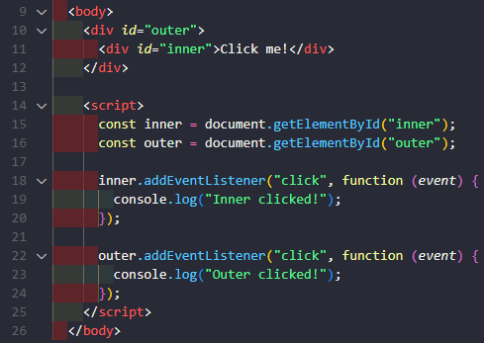
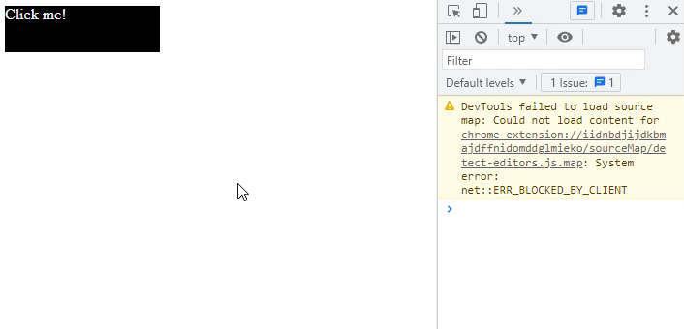
Code Example - Bubbling Event Propagation
The first listener, listens for "click" events on the `inner` div element and logs "Inner clicked!" to the console when triggered.
The second listens for "click" events on the `outer` div element and logs "Outer clicked!" to the console when triggered.
When the "Click me!" text is clicked, the "click" event is triggered on the `inner` element first, then bubbles up to the `outer` element, triggering both event listeners.

Slide 4
Introduction to Event Delegation
Event delegation is a technique that takes advantage of event bubbling to handle events more efficiently.
Instead of attaching event listeners to every element, you attach a single event listener to a parent element.
When the event bubbles up to the parent element, you can use the event target to determine which child element was clicked.

Slide 5
Benefits of Event Delegation
Event delegation reduces the number of event listeners needed, which can improve performance and reduce memory usage.
Event delegation makes it easier to dynamically add or remove elements without having to update event listeners.
Event delegation can simplify event handling code, especially for complex or nested DOM structures.

Slide 6
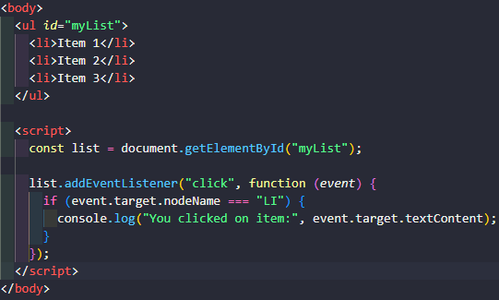
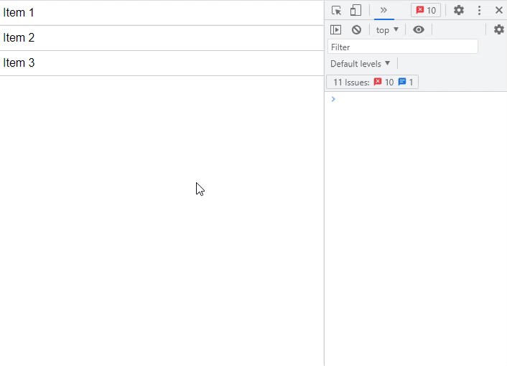
Code Example - Bubbling Event Propagation

Slide 7
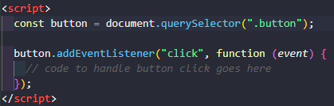
Limitations of Event Delegation
While event delegation is a powerful technique, it may not be suitable for every situation.
In some cases, attaching event listeners directly to individual elements may be more appropriate.
Event delegation can also be more complex to implement in certain situations, such as when handling drag and drop events.
Code Example –
Attaching Listener to Individual Element

Slide 8
When to Use Event Delegation
Event delegation is best used when you have a large number of similar elements that need to handle the same event.(e.g. Navbar)
It can also be useful when working with dynamic content that may be added or removed from the DOM.
When in doubt, test different approaches to see which one works best for your specific situation.

Slide 9
Advanced Event Delegation Techniques
There are many advanced techniques you can use with event delegation to further customize your event handling code.
For example, you can use (event.target) to traverse up the DOM tree and find specific parent elements.
You can also use (event.stopPropagation() ) to prevent further propagation of an event, or (event.stopImmediatePropagation() ) to stop propagation and prevent other event listeners from firing.

Slide 10
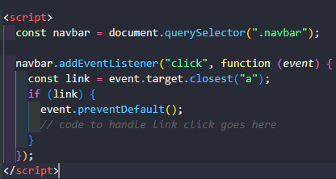
Code Example - Finding Specific Parent Elements

Slide 11
Conclusion and Recap
Event delegation is a powerful technique for handling events in JavaScript.
It allows us to handle events on a container element instead of handling them on each individual child element.
Event delegation is useful for dynamic UIs with many elements, as it reduces the amount of event listeners needed and simplifies the code.
Two common scenarios for using event delegation are handling clicks on dynamically created elements and handling events on a list with many items.
Best practices for working with event delegation include choosing the appropriate container element, avoiding unnecessary event handlers, and using event.target to check the target element.
By mastering event delegation, you can create more efficient, scalable, and maintainable code for your web applications.

Slide 12
Thank You!
Thank you for taking the time to watch this brief presentation on JavaScript event delegation. I hope you find it useful and informative, Please do not hesitate to contact me if you have any questions or feedback.
Presented by [Mohammad Shebli]

